Slide 1
Uninformed Search Strategies
Instructor: Dr. Wei Ding
Notes:
9/23 slide 12

Slide 2
Uninformed Search Strategies
Also called blind search.
Have no additional information about states beyond that provided in the problem definition
All can do is to generate successors and distinguish a goal state from a nongoal state
5 uninformed search strategies: breadth-first, uniform-cost, depth-first, depth-limited, iterative deepening

Slide 3
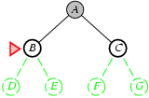
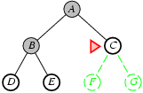
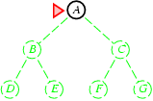
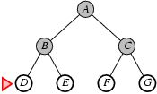
Breadth-First Search
Expand shallowest unexpanded node
Implementation:
Fringe is a FIFO queue. E.g., new successors go at end.

Slide 4
Properties of Breadth-First Search
Complete? Yes if b is finite, b: maximum branching factor (maximum number of successors) of the search tree.
Time? 1+b+b²+b³+… +b^{d} + b(b^{d}-1) = O(b^{d+1})
Suppose the solution is at depth d. In the worst case, we would expand all but the last node at level d, since the goal itself is not expanded, generating b^{d+1} – b nodes at level d+1
Space? O(b^{d+1}) (keeps every node in memory)
Optimal? Yes if cost =1 per step
Space is the bigger problem (more than time).
Notes:
Breadth-first search find the shallowest goal

Slide 5
Why space is the bigger problem?
Depth | Nodes | Time | Memory
2 | 1100 | .11 seconds | 1 megabyte
4 | 111,100 | 11 seconds | 106 megabyte
6 | 10⁷ | 19 seconds | 10 gigabytes
8 | 10⁹ | 31 hours | 1 terabytes
10 | 10¹¹ | 129 days | 101 terabytes
12 | 10¹³ | 35 years | 10 petabytes
14 | 10¹⁵ | 3,523 years | 1 exabyte
Assume branch factor b=10; 10,000 nodes/second; 1000 bytes / note.

Slide 6
Uniform-cost search
Expand least-cost unexpanded node
If all step costs are equal, this is identical to breadth-first search
Implementation:
Fringe = queue ordered by path cost
Notes:
We can guarantee completeness provided the cost of every step is greater than or equal to some small positive constant epsilon.
This condition is also sufficient to ensure optimality.

Slide 7
Depth-first search
Expand deepest unexpanded node
Implementation:
Fringe = LIFO queue, e.g., put successors at front

Slide 8
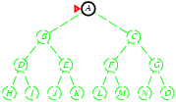
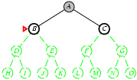
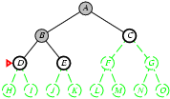
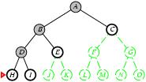
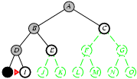
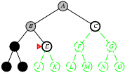
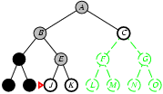
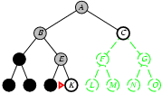
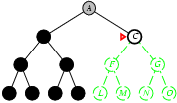
Example: Depth-first search

Slide 9
Properties of depth-first search
Complete? No: fails in infinite-depth spaces, spaces with loops
Modify to avoid repeated states along path
Complete in finite spaces
Time? O(b^{m}). m: maximum depth of the state space. Terrible if m is much larger than d.
Space? Requires storage of only bm+1 nodes, so O(bm), linear space!
Optimal? No
Notes:
D is the depth of the least cost solution

Slide 10
Properties of depth-first search
Very modest memory requirements
Store only a single path from the root to a leaf node
Once a node has been expanded, it can be removed from memory as soon as all its descendants have been fully explored.
☹ It can make a wrong choice and get stuck going down a very long (or even infinite) path when a different choice would lead to a solution near the root of the search tree.

Slide 11
Depth-limited search
= depth-first search with depth limit l.
Nodes at depth l are treated as if they have no successors.
Introduces an additional source of incompleteness if we choose l<d, that is, the shallowest goal is beyond the depth limit.

Slide 12
Iterative deepening search
Combination with depth-first search.
Gradually increasing the limit – first 0, then 1, then 2, and so on – until a goal is found.

Slide 13
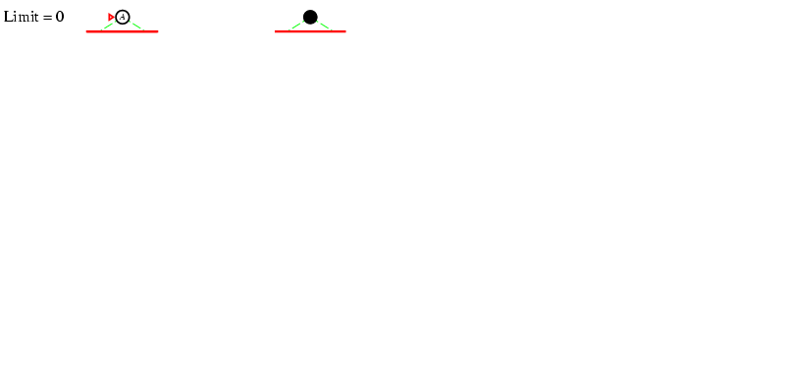
Iterative deepening search l =0

Slide 14
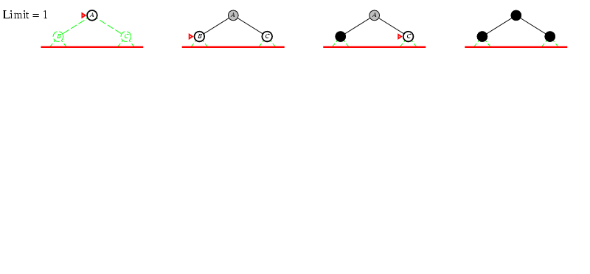
Iterative deepening search l =1

Slide 15
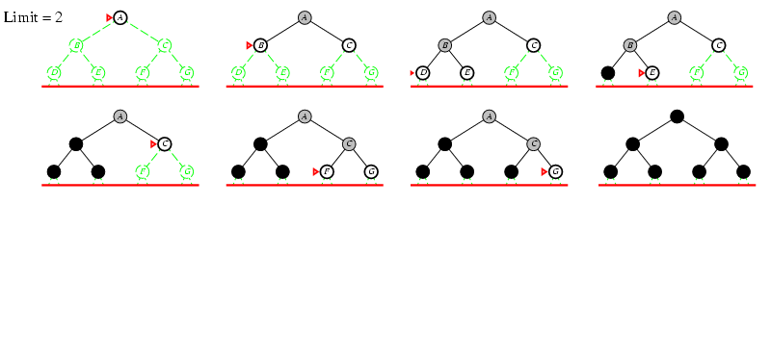
Iterative deepening search l =2

Slide 16
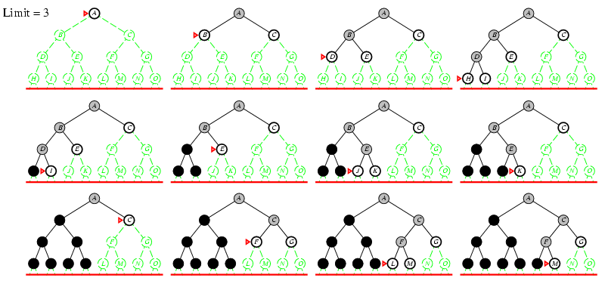
Iterative deepening search l =3
Notes:
Iterative deepening search may seem wasteful, because states are generated multiple times.

Slide 17
Properties of iterative depth-first search
Complete? Yes
Time? O(b^{d})
Space? O(bd)
Optimal? Yes, if step cost=1
Why not O(bm)?
Notes:
In general, iterative deepening is the preferred uninformed search method when there is a large search space and the depth of the solution is unknown.

Slide 18
Iterative Deepening Search May Seem Wasteful
Fact: In a search tree with the same (or nearly the same) branching factor at each level, most of the nodes are in the bottom level
In an iterative deepening search, the nodes on the bottom level (depth d) are generated once
N(IDS)=(d)b +(d-1)b²+…+(1)b^{d}
For example, if b=10 and d=5, the numbers are
N(IDS) = 50 + 400 + 3,000+20,000+100,000 = 123,450
N(BFS) = 10 + 100 + 1,000+10,000+100,000=111,110
O(b^{d})

Slide 19
In general, iterative deepening is the preferred uninformed search method when the search space is large and the depth of the solution is not known.

Slide 20
Repeated States
Each state may be reached in more than one way.
The possibility of wasting time by expanding states that have already been expanded before somewhere else on the search tree.

Slide 21
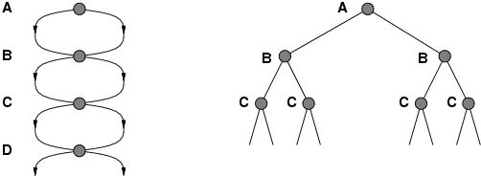
Avoiding repeated states
Failure to detect repeated states can turn a linear problem into an exponential one!

Slide 22
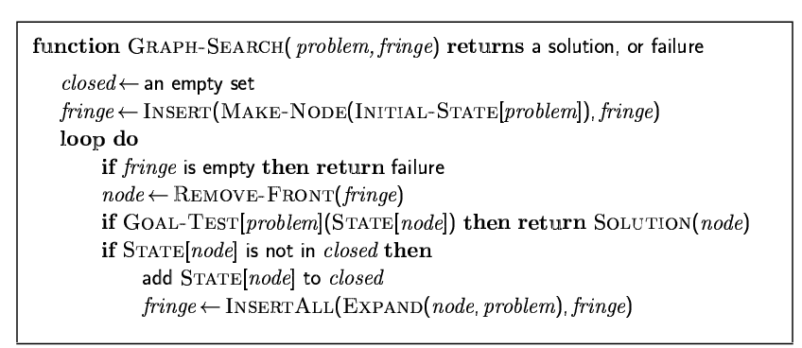
Graph search

Slide 23
Tradeoff between space and time
Algorithms that forget their history are doomed to repeat it.
Closed list: stores every expanded node.

Slide 24
Avoiding Repeated States
Three principal ways to deal with repeated states
Do not return to the state you just came from
Do not create paths with cycles in them
Do not generate any state that was ever generated before

Slide 25
Summary
Before an agent can start searching for solutions, it must formulate a goal and then use the goal to formulate a problem.
A problem consists of four parts: the initial state, a set of actions, a goal test function, and a path cost function.
The environment of the problem is represented by a state space.
A path through the state space from the initial state to a goal sate is a solution.

Slide 26
Summary
Search algorithms are judged on the basis of completeness, optimality, time complexity, and space complexity. Complexity depends on b, the branching factor in the state space, and d, the depth of the shallowest solution.

Slide 27
Summary
Breadth-first search selects the shallowest expanded node in the search tree for expansion.
Complete, optimal for unit step costs, time and space complexity of O(b^{d+1}).
The space complexity makes it impractical in most cases.
Depth-first search selects the deepest unexpanded node in the search tree for expansion.
Neither complete nor optimal, time complexity of O(b^{m}) and space complexity of O(bm), where m is the maximum depth of any path in the state space.
Iterative deepening depth-first search calls depth-limited search with increasing limits until a goal is found.
Complete, optimal for unit step cost, time complexity of O(b^{d}) and space complexity of O(bd).

Slide 28
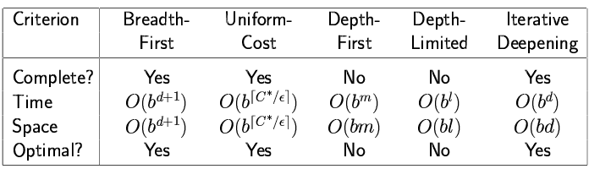
Five Search Strategies
b: maximum branching factor (maximum number of successors) of the search tree
d: depth of the least-cost solution
m: maximum depth of the state space (may be ∞)
l: depth limit
Notes:
C: cost of the optimal solution
Epsilon: Minimum cost of every path

